Slide 1
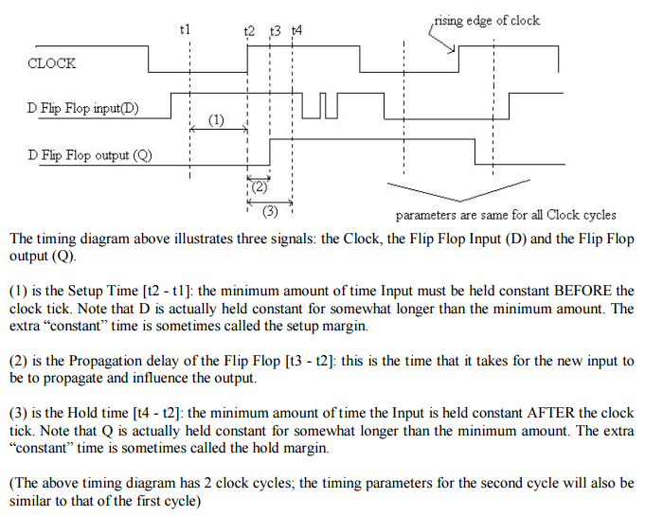
Setup and Hold Time

Slide 2
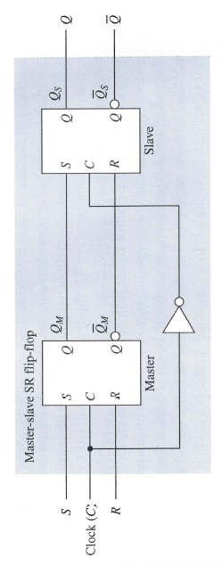
Master-Slave SR Flip-Flop
Two sections, each capable of storing a binary symbol.
First section is referred to as the master and the second section as the slave.
Information is entered into the master on one edge or level of a control signal and is transferred to the slave on the next edge or level of the control signal.
Each section is a latch.

Slide 3
Master-Slave SR Flip-Flop
C = 0:
Master is disabled. Any changes to S,R ignored.
Slave is enabled. Is in the same state as the master.
C = 1:
Slave is disabled (retains state of master)
Master is enabled, responds to inputs. Changes in state of master are not reflected in disabled slave.
C = 0:
Master is disabled.
Slave is enabled and takes on new state of the master.
Important: For short periods during rising and falling edges, both master and slave are disabled.

Slide 4
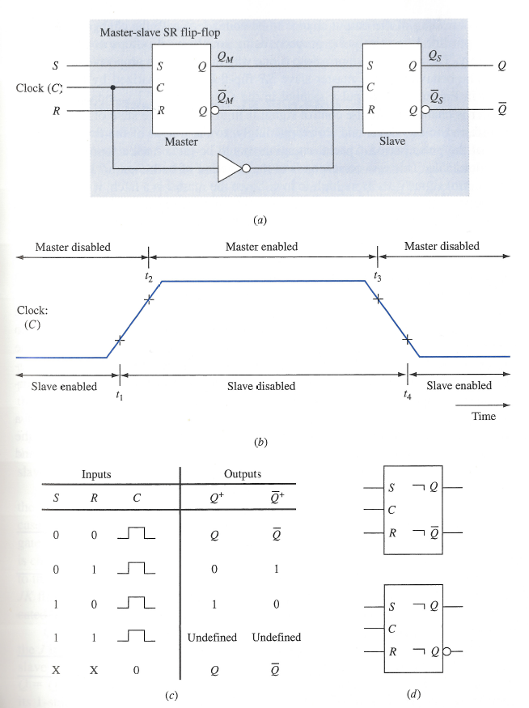
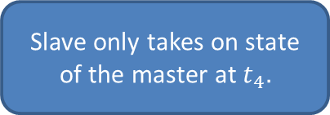
Master-Slave SR Flip-Flop
Slave only takes on state of the master at
Pulse symbol indicates master enabled when C = 1 and state of master transferred to slave at the end of the pulse period.
Postponed output indicator: output change postponed until end of pulse
If S, R = 1 when control signal goes from high to low we are in an unpredicable state. Can cause metastable state.

Slide 5
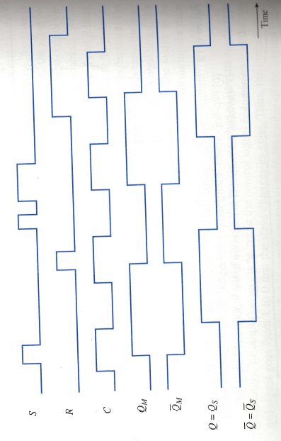
Timing Diagram for
Master-Slave SR flip-flop

Slide 6
Master-Slave JK Flip-Flop
The output state of a master-slave SR flip-flop is undefined upon returning the control input to 0 when S = R = 1.
Necessary to avoid this condition.
Master-slave JK flip-flop allows its two information input lines to be simultaneously 1.
Results in toggling the output of the flip flop.

Slide 7
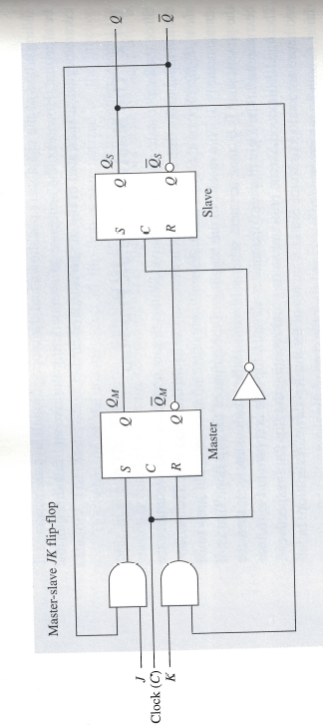
Master-Slave JK Flip-Flop
Assume in 1-state, C = 0, J = K = 1.
Due to feedback, the output of the J-gate is 0, output of K-gate is 1.
If clock is changed to C = 1 then master is reset.
Assume in 0-state, C = 0, J = K = 1.
Due to feedback, the output of the J-gate is 1, output of K-gate is 0.
If clock is changed to C = 1 then master is set.
1 on J input line, 0 on K input line sets the flip-flop.
If in 1-state, unchanged b/c S,R set to 0.
If in 0-state, S set to 1, R set to 0.
0 on J input, 1 on K input line resets the flip-flop. Why?

Slide 8
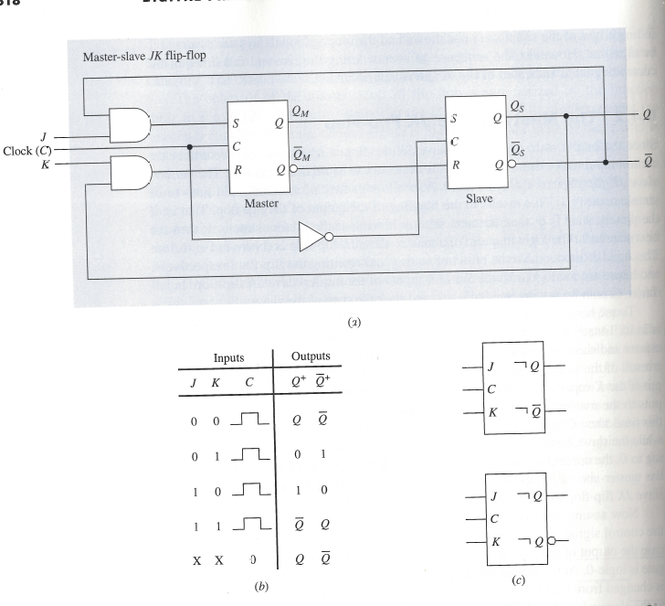
Master-Slave JK Flip-Flop

Slide 9
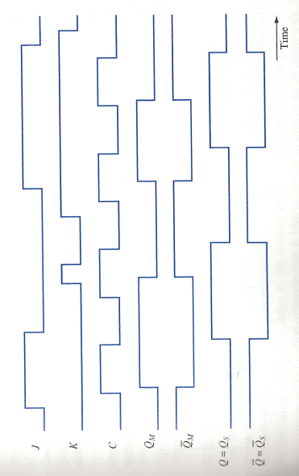
Timing Diagram for
Master-Slave JK Flip-Flop

Slide 10
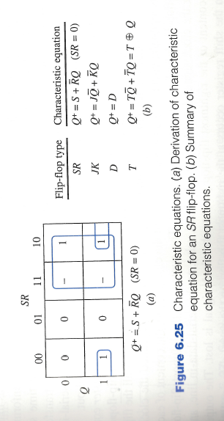
Characteristic Equations

Slide 11
Registers
A collection of flip-flops taken as an entity.
Function: Hold information within a digital system so that it is available to the logic elements during the computing process.
Each combination of stored information is known as the state or content of the register.
Shift register: Registers that are capable of moving information upon the occurrence of a clock-signal.
Unidirectional
bidirectional

Slide 12
Registers
Two basic ways in which information can be entered/outputted
Parallel: All 0/1 symbols handled simultaneously. Require as many lines as symbols being transferred.
Serial: Involves the symbol-by-symbol availability of information in a time sequence.
Four possible ways registers can transfer information:
Serial-in/serial-out
Serial-in/parallel-out
Parallel-in/parallel-out
Parallel-in/serial-out

